Slide 1
Exploring The Gap in Web Application Security Courses
Zach Steele
PUBP6727
07/20/2025
Notes:
Project GitHub: https://github.gatech.edu/zsteele3/ZS6727Summer2025
YouTube Series: https://www.youtube.com/watch?v=TcrWRL9CZh8&list=PLqPCUirqsN_x_seY51DiivfV-CjgJDKUp

Slide 2
Introduction
Work experience
Penetration tested over 150 applications.
Explain reproduction methodologies.
Teach remediation guidance.
Point developers to pre-existing secure code.
4 years as a developer.
The research
Developers do not see application security as a top priority.¹
Only 69% of critical vulnerabilities receive patches.²
43% increase in CVEs reported in 2023 compared to 2021.³
AI code assistants are increasing the amount of insecure code in applications.⁹
Notes:
I have pentested over 150 applications during my career as a penetration tester, and before that I spent a few years on multiple dev teams. It is my responsibility to teach the app teams how to reproduce our findings with tools that are available to them, and then we give high level remediation guidance. If prompted, we will point them to specific code snippets and articles that they can significantly benefit from. While doing this job, I have notice a gap between the security teams and the dev teams. It is clear that the dev teams don't take security seriously and they are often a fish out of water when it comes to reproducing vulnerabilities. While this prompted my project idea, it's important to backup everything with research. My early research for this project proved that developers are more focused on hitting deadlines then they are security, and they often struggle to remediate vulnerabilities. With more and more new CVEs every year and a large amount of companies not participating in pentests, I knew this project was something that I needed to do. Before I go any further, I want to make it clear that I respect developers and completely understand why they are not security focused. This project is in no way trying to talk down to developers. I really don't like that mindset that a lot of people in security unfortunately have.

Slide 3
The Problem
Web application vulnerabilities continue to rise each year due to the gap in training courses and tooling options available to developers.
Courses are often too high level, or require massive time commitments.
68% of developers only do secure code training because of a compliance need or recent exploit.⁵
88% of respondents were not aware of a good course or cited time constraints as their primary reason for not taking secure coding courses.⁶
Programmers cannot utilize penetration testing tools due to corporate policies and time constraints.⁷
68% of companies do not do annual or bi-annual penetration tests.⁴
Notes:
My problem statement is: “Web application vulnerabilities continue to rise each year due to the gap in training courses and tooling options available to developers.” As I continued doing research, it became clear that developers did not have access to the right courses because secure coding courses were often too high level and penetration testing courses target a different audience with different tool sets. So if a developer wants to ensure their application does not have vulnerabilities before deploying to production, they are left with extremely in-depth penetration testing courses that utilize tools and scanners unavailable to the app team or bullet points on a powerpoint that do not translate to real action items. I made a comparison of multiple courses showing their pros and cons for my final paper, but I won't be showing that here today. It is linked in the notes section of this slide.
Course Comparison: https://github.gatech.edu/zsteele3/ZS6727Summer2025/blob/main/ClassSubmissions/Similar%20Courses.xlsx

Slide 4
My Solution
My goal is to teach developers how to efficiently identify and remediate vulnerabilities in their applications, without using penetration testing tools, to reduce the likelihood of deploying insecure code to production.
Web application penetration testing course for developers.
Vulnerability checklist.
Payload lists and malicious files for testing.
Third party references for further education.
Secure coding practices template.
Video series teaching penetration testing concepts.
How is this unique?
No penetration testing tools required.
Focused on discovering vulnerabilities.
Show real world examples.
Reduced overhead.
Notes:
My solution is “to teach developers how to identify and remediate vulnerabilities in their applications, without using penetration testing tools, to reduce the likelihood of deploying insecure code to production by creating a penetration testing course for developers.” I make it clear to the audience that there are more comprehensive resources out there that will teach edge cases and much more depth to each topic. Since our goal is to see developers test their own applications and make real change, I focused on discovering vulnerabilities instead of getting full exploitation and I wasn't afraid to point to other resources when necessary since that was a complaint made by developers in one of the previously cited sources. One organization might be better for SQL injection remediation while a different site might be better for XSS exploitation, just as an example. My solution is unique because it does not require any penetration testing tools, in fact most of the course requires just a browser, I focus on showing real world examples and vulnerability discovery to keep the time investment low for the viewer since developers said time constraints were one of the main reasons they did not take more courses.

Slide 5
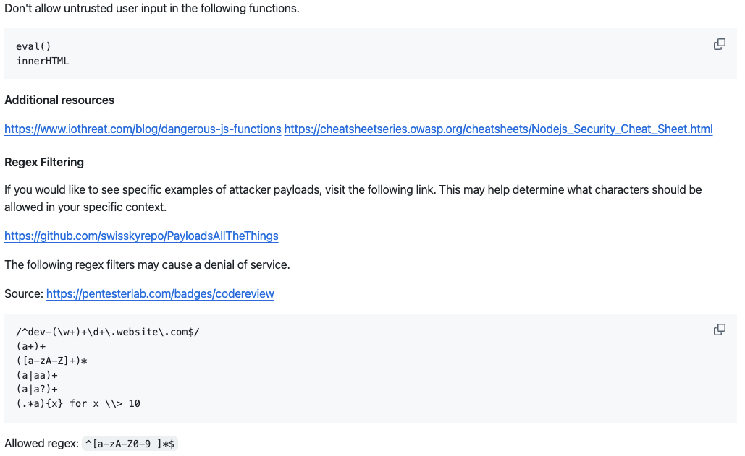
Code Analysis Resources
One of the first videos in the series teaches code review basics and provides links to third party learning resources. The goal of this content is to encourage developers to start focusing on their code as they are building new functionality. I highlight the OWASP⁸ checklist and code review guide as the framework for creating strong coding standards within a development team. Lastly, I provide real examples of vulnerable code alongside the secure corrections.
Notes:
Code Review Page: https://github.gatech.edu/zsteele3/ZS6727Summer2025/blob/main/CodeAnalysis.md

Slide 6
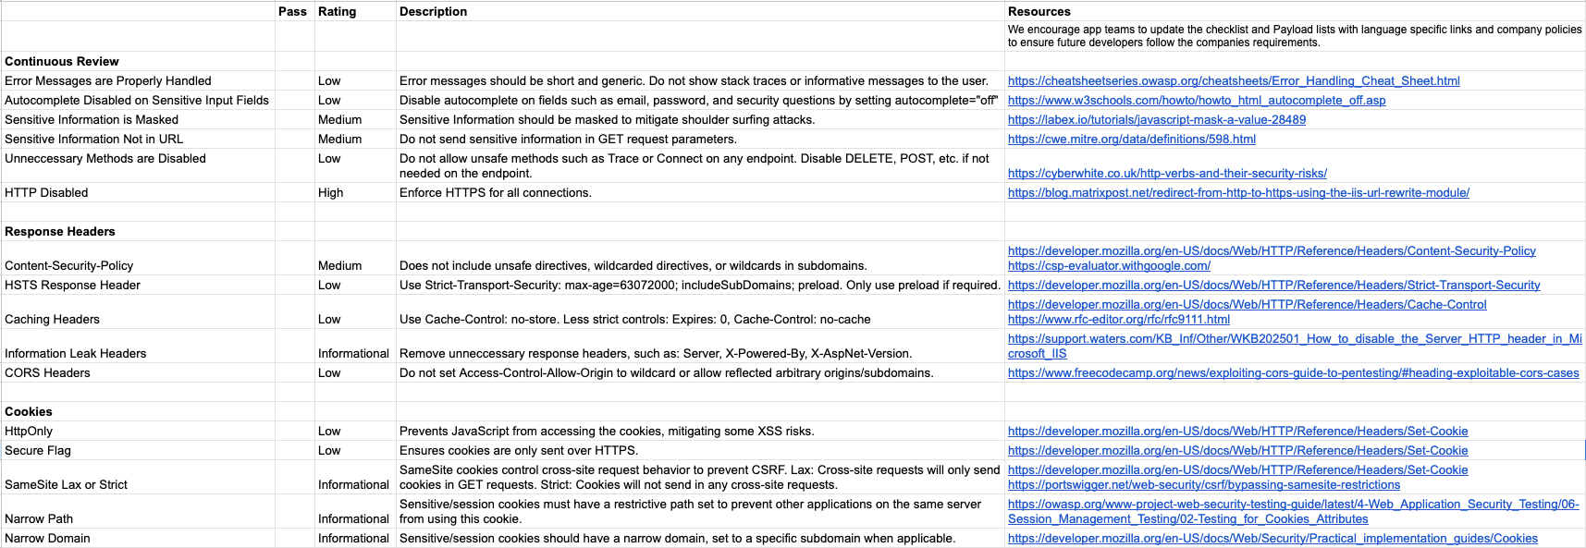
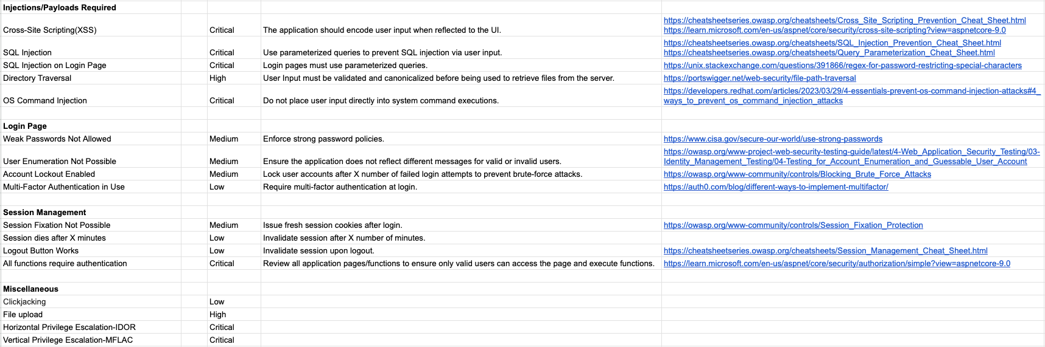

Full Page Photo
Notes:
Checklist: https://github.gatech.edu/zsteele3/ZS6727Summer2025/blob/main/PracticumProjectChecklist.xlsx
This image shows 26 of our checklist items, but the full checklist included 33 items. That does not include the optional checks.
The checklist was populated with roughly 3 categories in mind. First, vulnerabilities and misconfigurations that were easy and quick to find. This is the response headers, cookies, and some of the continuous review items. These items were backed up by more than just my own experience and best practices found from other checklists that have been generated by pentesting firms. For example, CSPs are a quick check that have the power to stop cross site scripting and clickjacking, but only 2% of the top 1000 most visited sites have a secure CSP implementation. (Pacheco, 2020)
The second category is items that require payloads, meaning the developer may need approval to test and these items open up the door for user input handling based remediation. These items are based off of research like Freeman (2023) reporting their pentesting firm seems to find XSS most commonly or DB-Engines (2025) reporting that 4 out of the top 5 database models are still SQL. The third category is supporting items like MFA and user enumeration. This was to round out the checklist and assist with over arching vulnerability types like account takeover.

Slide 7
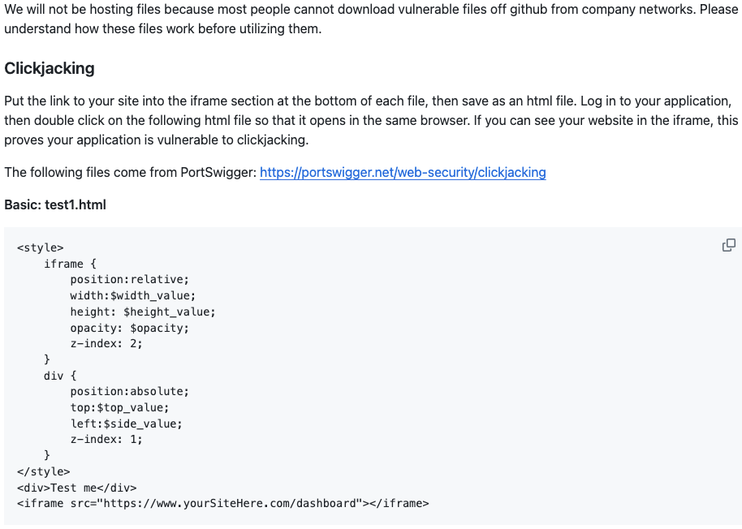
Malicious Files
Multiple test cases require malicious files with different payloads and file extensions. I walk through each file and their intended behavior while stressing that we cannot test with files found online due to unknown security risks they may present. Since most organizations do not allow employees to download specific file types or content, I provide the file contents for the user to copy paste. In the event that company policies prevent employees from using our files, I also teach the viewer to rely on non-malicious files that are already on their computer by default.
Notes:
Test Files: https://github.gatech.edu/zsteele3/ZS6727Summer2025/blob/main/TestFiles.md
Please note that these files do not cause impact.

Slide 8
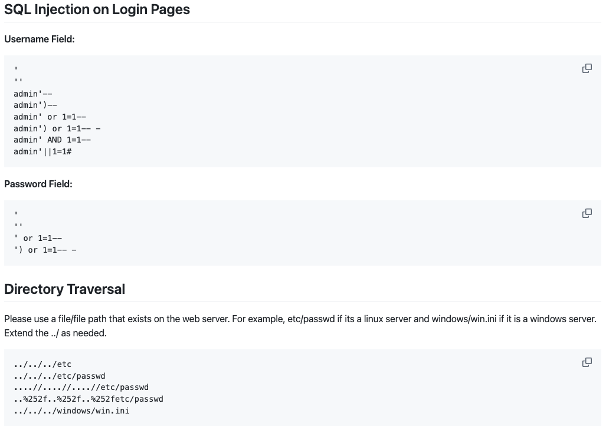

Payload Lists
Viewers can choose between the short payload list and the long payload list for all checklist items. The long payload list includes more payloads for greater coverage, while the short payload list focuses on the highest success rate payloads for various situations. The payloads were chosen based on my experience as a penetration tester, where I have built out my own flowcharts and cheat sheets to test more efficiently.
Notes:
Short Payload List: https://github.gatech.edu/zsteele3/ZS6727Summer2025/blob/main/ShortPayloadList.md
Long Payload List: https://github.gatech.edu/zsteele3/ZS6727Summer2025/blob/main/LongPayloadList.md
I created a short payload list and a long payload list. The difference being the longer payload list requires more time to run all the test cases, but there are a few payloads that are more likely to get caught by the security departments controls or they cause true impact on the server. That impact is never something that would introduce true risk. Additionally, the long payload list contains real world examples from HackerOne write ups.

Slide 9
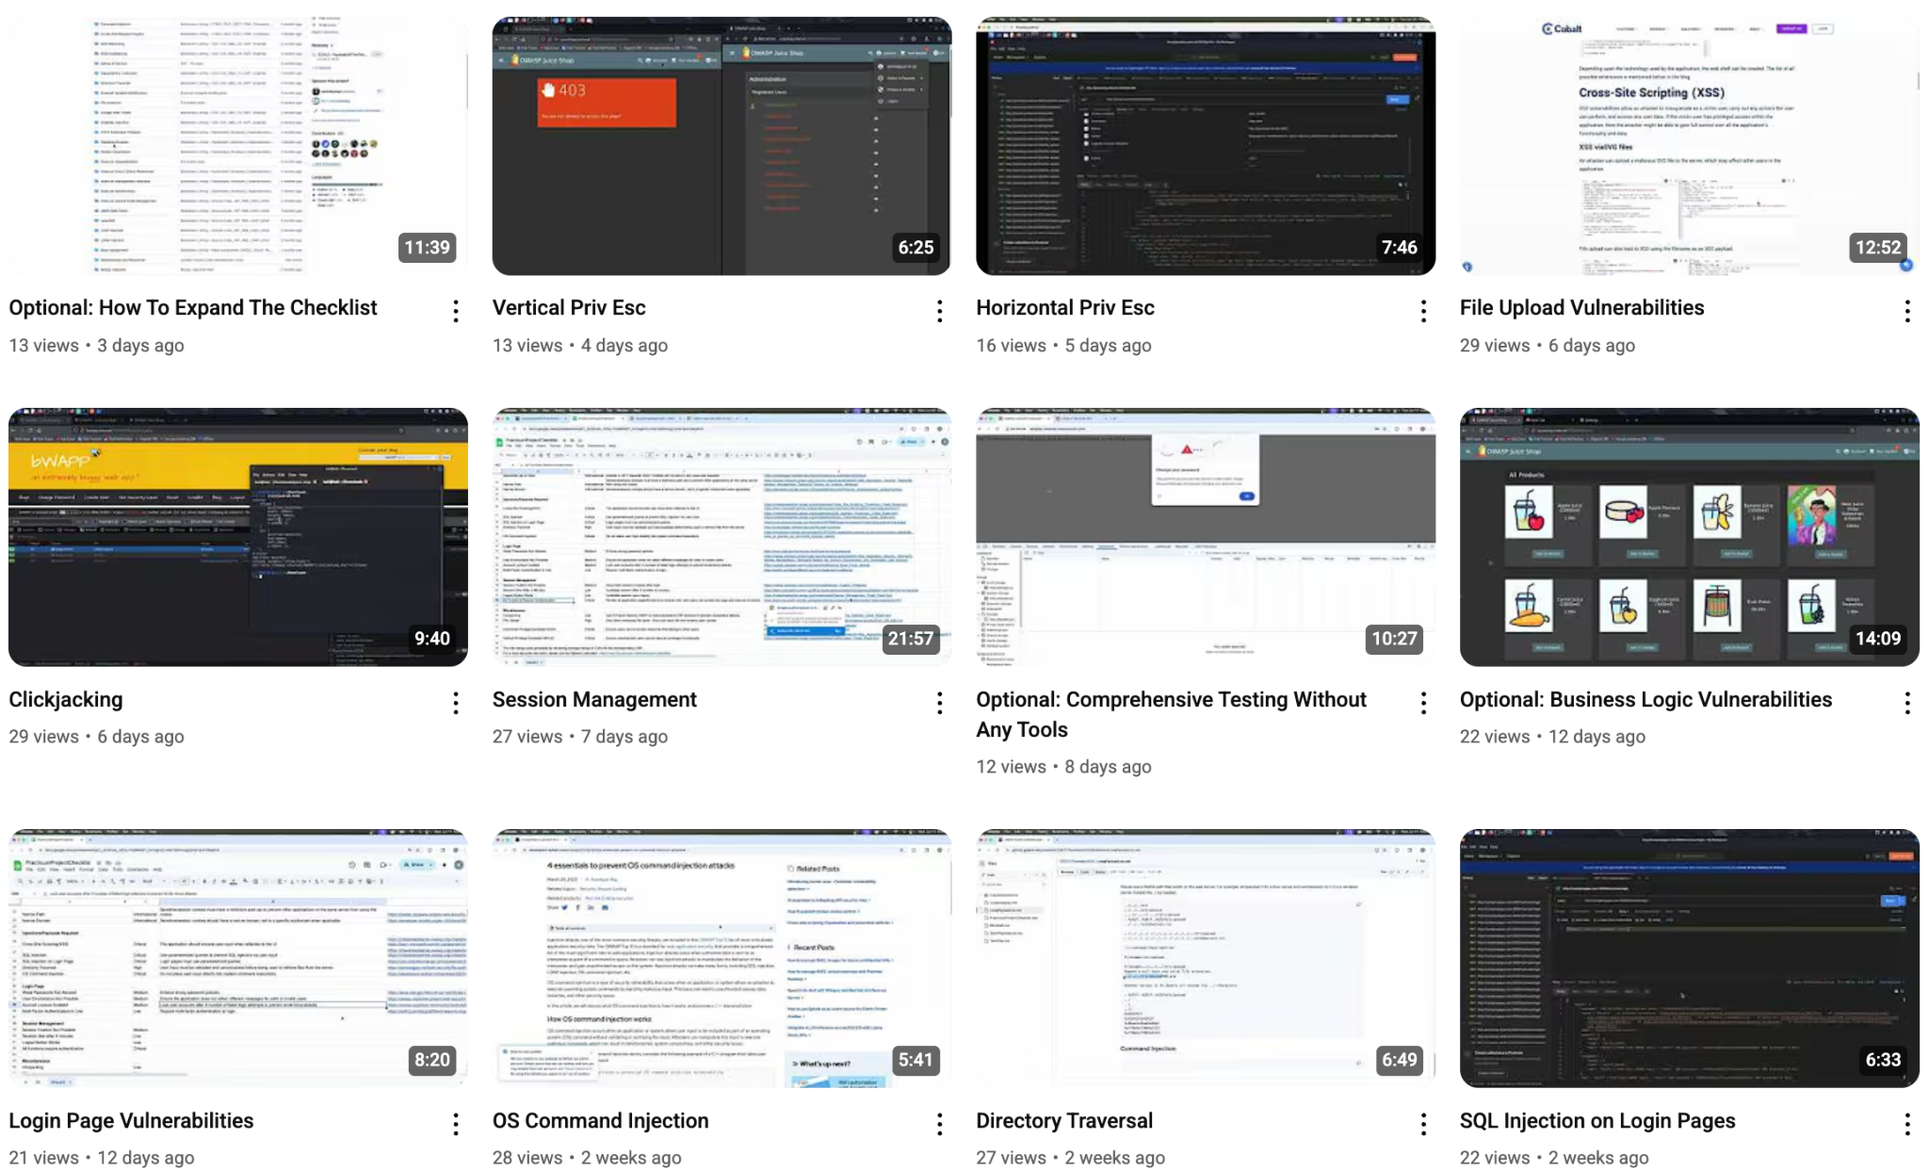
Video Series
The YouTube video series walks the viewers through the purpose of this course, how to use the material, and how to safely add new test cases even if the viewer does not fully understand how to exploit vulnerabilities in that category. Each video contains a timeline, allowing the user to quickly skip around to relevant test cases or sections of each checklist item. Lastly, the video descriptions contain links to the material shown in the demo and any relevant third party resources to learn more about the vulnerabilities, exploits, and remediation.
Notes:
YouTube Playlist: https://www.youtube.com/watch?v=TcrWRL9CZh8&list=PLqPCUirqsN_x_seY51DiivfV-CjgJDKUp
The video series totaled over 4.5 hours. We covered the original 33 checklist items in about 3.5 hours.

Slide 10
Evaluation
Surveyed managers, application owners, penetration testers, and developers.
Pre-training survey
Work Experience.
Experience with penetration testing/secure coding courses.
Course improvement opportunities.
Confidence identifying vulnerabilities.
Post-training survey
Test an app with the course material.
Provide results and feedback.
Confidence identifying vulnerabilities.
Thoughts on testing frequency and audience.
Interviews
Extract more information from the viewers.
Notes:
Pre-Training Survey: https://docs.google.com/forms/d/e/1FAIpQLScr7ZO2vqLFal6yhE-ndr7Qo0nLlu5zlpPwyZEq136vftufGg/viewform?usp=dialog
Post-Training Survey: https://docs.google.com/forms/d/e/1FAIpQLSfVvHB7FBz02gWPTqRM5hdIY1HqudfQ0KEn-rv2OB3C6Td8wQ/viewform?usp=dialog
We already discussed how I chose the checklist items and payloads based off of experience and research, however, the course and its contents are only valuable if developers actually use it and take action in their own applications because, again, the goal of this course is to reduce vulnerabilities by upskilling developers and getting them to test their own applications.
To evaluate the course I surveyed managers, app owners, penetration tests, and developers to learn about their experiences with other courses, and their confidence identifying vulnerabilities.
Then, I gave those participants the training course and asked them to provide feedback about the course, use the material to test an application, and their confidence level after using the material.

Slide 11
Survey Limitations
Personal Bias
Friends may feel pressure to give favorable responses.
Selection Bias
Penetration testers will be less likely to learn from my material, but more likely to see potential value.
Developers were more likely to increase confidence in testing after viewing the course.
Non-Responsive Bias
Less than half of the recipients completed the pre-training survey.
Half of that group completed the post-training survey.
Response Bias
Making unbiased survey questions can be extremely difficult.
Notes:
Personal Bias: Most of the respondents have a personal relationship with me, potentially reducing the negative feedback.
Selection Bias: The sample size was less than 50 participants. Most respondents had less than 10 years in the tech industry.
Non-responsive Bias: Why did recipients not complete the first survey? Additionally, why did some people complete the first survey, but not the second survey? Most likely due to the ask before taking survey 2.
Response bias: Probably the most important limitation to take with me as this project grows in the future is upgrading my surveys to reduce response bias. Its really important to come up with balanced questions that do not lead the participant to a specific answer. (Qualtrics, n.d)
Without reading everything on the screen, I do want to point out the multiple biases at play here. The survey was first shared with friends and peers that met the participant criteria. Then, the course spread rapidly. I had over 550 views across 120+ unique viewers with a total watch time of over 40 hours. Meaning the survey participation numbers were pretty low. I will talk about some of these other bullets in a moment.

Slide 12
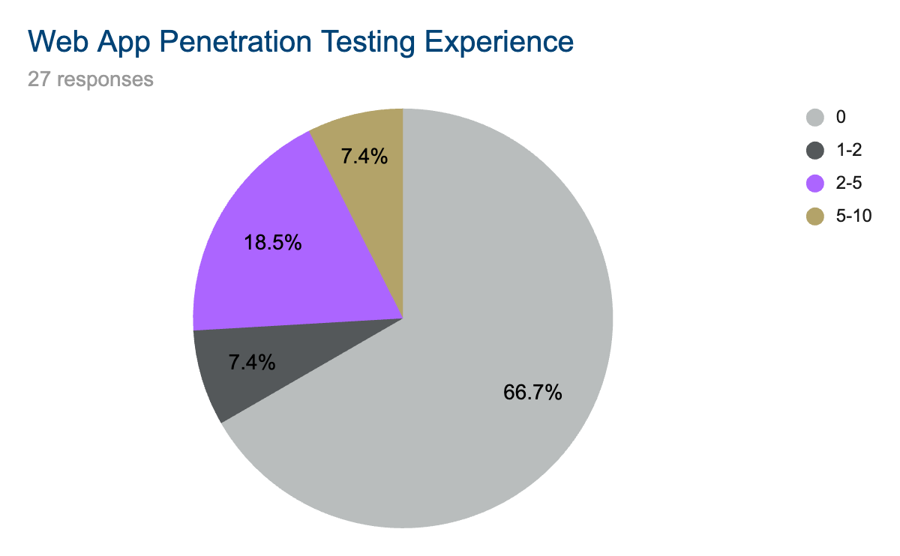
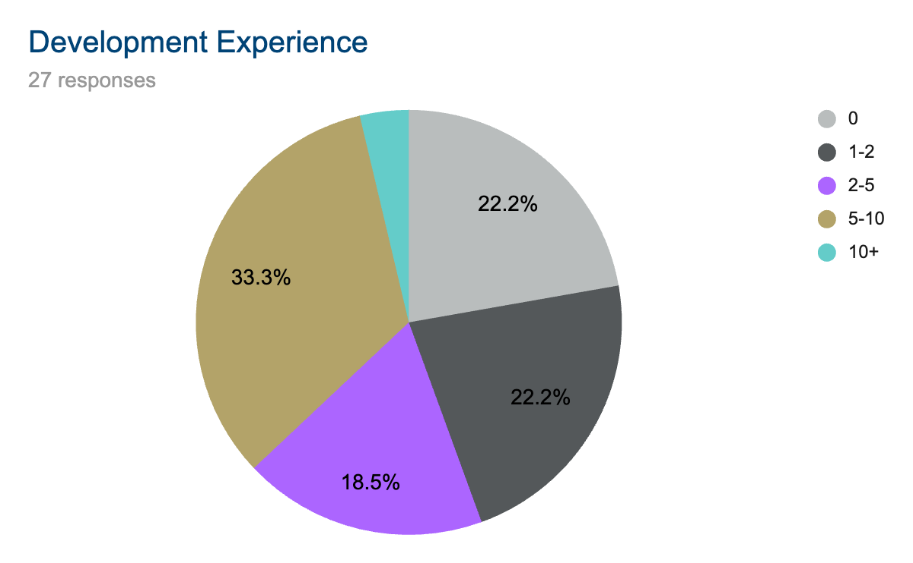
Survey Participants
Notes:
Less than half the respondents have web app pentesting experience, while almost 80% have development experience. This is important because developers are more likely to learn from the course, while a pentester is most likely going to come out of this course with the same knowledge they had before. Which will affect the confidence ratings shown in a moment.

Slide 13
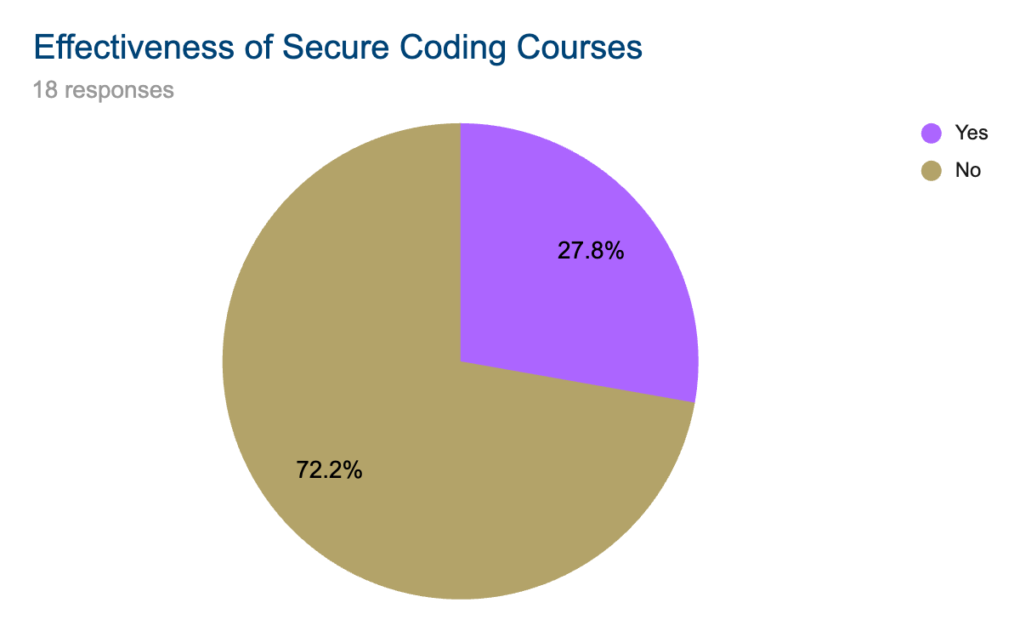
Past Course Feedback
72% of respondents stated that past secure coding courses and trainings did not improve their ability to write secure code or identify vulnerabilities within their code base. The group explained the biggest issues with secure coding courses are the lack of real world examples, reliance on powerpoint training, and a lack of material to continue learning after the course is over.
Notes:
Respondents were much more likely to learn from web app pentesting courses, but true to our research, a lot less participants had ever taken a pentesting course before.

Slide 14
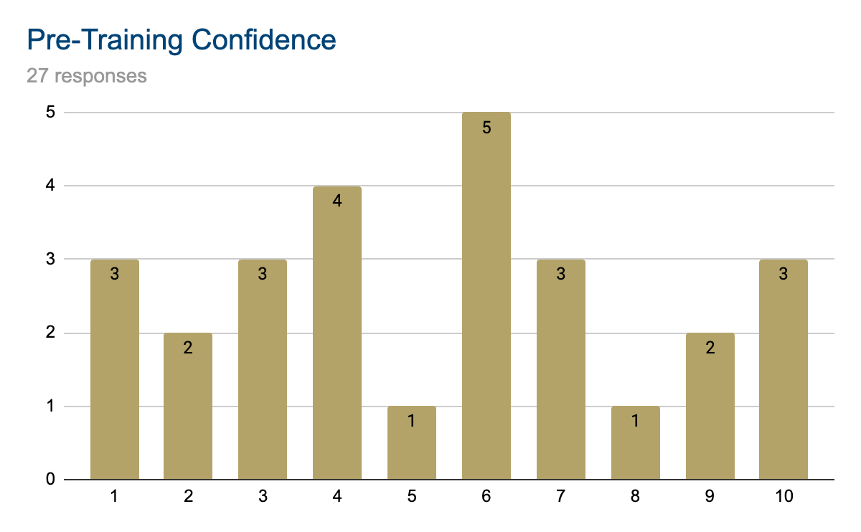
Pre-Training Survey Results Cont.
Notes:
The average pre-training confidence for all 27 respondents was 5.33. If we exclude participants that did not complete the post-training survey, the confidence shifts to 5.58. If we exclude penetration testers with a confidence rating of 9-10 and our two outliers that we will discuss in a moment, we get an average confidence rating of 4.14.

Slide 15
Post-Training Survey Results
Survey Complications
Two participants lowered their confidence after watching the videos due to overconfidence prior to seeing the exploits.
During interviews, respondents mentioned their hesitance towards edge ratings.
Video Series Learning Opportunities
100% of participants with less than 2 years of pentesting experience learned from the series.
94.7% stated the course improved their understanding of risk and remediation.
13 individuals used the material to find vulnerabilities within an application.
Most respondents recommended the training for all developers.
Participants recommended dev teams test their application using my course before major code releases or on an annual basis.
Notes:
First, lets discuss the outliers. Two participants lowered their confidence rating after the videos, seemingly saying that the videos reduced their ability to discover vulnerabilities. However, the two participants confirmed that they lowered their confidence because the videos showed how little they truly knew about these exploits. This hurt their confidence, causing lower scores even though they both said they learned a lot from the course. Something that I learned from the interviews was that the developers who took this course loved seeing real exploitation because even though they have heard a lot of these terms like XSS or SQLi, they had never seen an actual attack demonstrated. That will help them internalize the concepts and risk for future code deployments.
Overall, the survey results were great. Developers used this course to actually find vulnerabilities within their applications, proving that we can efficiently find vulnerabilities using small payload lists. Participants loved the course and believed the course should be viewed by the whole dev team. They also said the testing should be completed anywhere from annually down to every major code release. Multiple participants asked if they could show this material to their teammates and friends.

Slide 16
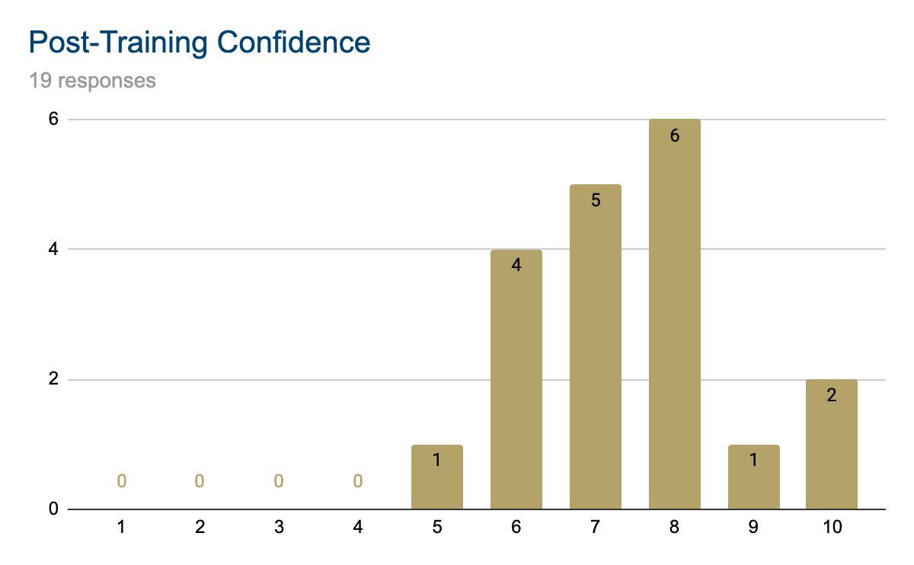
Post-Training Survey Results Cont.
Notes:
The average post-training confidence for all 19 respondents was 7.42, which is an increase of 1.84. If we exclude penetration testers that already had a confidence of 9 or 10 and our two participants that put lower rating due to their admitted overconfidence coming into the video series, the new confidence rating is: 6.93, an increase of almost 2.8 points from the same pre-training group. I think this survey question should be tweaked in the future because nobody wants to put their ability to find vulnerabilities at a 1 or 2 and after the training no one wants to sound cocky and put their score at a 9 or 10, causing a cluster in the middle.

Slide 17
Solution Limitations
Edge Case Exploits and Payloads
We chose accessibility over exhaustive payload lists.
There is not enough research on specific payload success rates.
Lack of Topics
Focused on common vulnerabilities, leaving multiple less common categories untested.
Ex: WebSockets are only utilized in 7.3% of applications.¹⁵
Executive Buy-In
Team managers have to buy-in and give their devs the time to learn and test.
This could also assist with better metric tracking.
Notes:
I wanted to use the least amount of payloads to cover the most scenarios possible. It didn't make sense to double or triple the length of the course to add one off situations that are rarely seen. An example of that would be using CSP bypass payloads for XSS testing. We can identify XSS without ever attempting to bypass the CSP, so I chose to exclude those payloads.
Only 7.3% of the top 1000 most visited sites use WebSockets and an even smaller percentage of those WebSockets have significant implementations. (Murley et al., 2021) I do teach app teams how to add new categories like WebSockets on their own at the end of the course, but I didn't want to force the whole audience to watch the content when most of them would never interact with WebSockets in their own apps.
We need management buy-in to ensure the dev teams have the time to watch the series and start testing their apps. This would also help get more accurate survey results. Out of the 120 unique viewers on youtube, less than a third completed either survey. However, I did get over 50 hours of watch time from these individuals.

Slide 18
Future Work
Compile Feedback
Update course content to fill any gaps.
Re-film videos to better explain any lacking items.
Add new vulnerabilities to the course
Conduct research into new vulnerabilities.
Review survey feedback for desired new checklist items.
Update the survey to remove bias
Ensure participants are taking the survey seriously.
Fix the non-responsive bias.
Engage management teams for increased buy-in
Discuss the benefits of the course.
Attempt to restructure time allotment for the developers.
Notes:
I learned a lot throughout filming the video series. I would love to go back and clean up the videos using the most up to date GitHub pages and checklist. Additionally, I want to continue adding vulnerabilities to the optional course content while perfecting my survey questions to reduce bias. While this course was never a project that I imagined showing to co-workers, I’m excited to say that I have reached out to a few managers asking for their feedback and what steps we need to take before their dev teams fully implement this course.

Slide 19
Conclusion
The Research
Developers do not have the time or tools to utilize penetration testing courses.
Most secure coding courses are too high level to be helpful.¹
Bridging the gap
Created a penetration testing course designed for developers.
Short, high success rate, payload lists.
Easy to follow video series.
The Results
Developers saw a 2.8/10 confidence increase in detecting web app vulnerabilities.
13 participants used the course to find their first vulnerability.
Future Work to reduce limitations
Gaining management buy-in.
Expanding course content.
Rebuilding the survey.
Notes:
In conclusion, I identified a gap in current training courses leaving developers with few options for learning how to reduce the amount of vulnerabilities in their web applications. I bridged this gap by creating a web app pentesting course that used homemade payload lists designed for efficient coverage, a checklist of vulnerabilities to test for, and a plethora of additional resources for the developers to utilize. Then, i created a video series tying all of this material together, even teaching the audience how they can expand on the content and vulnerabilities themselves, all without using a single pentesting tool.
In the end, I received amazing feedback. The initial audience shared the series with over 100 people and everyone agreed the series accomplished my goals. We saw hard evidence that the course worked by seeing an increase in developers confidence testing for vulnerabilities and the survey results showing that participants had no issues using the course to identify real vulnerabilities within web applications. I look forward to continuing to build this course and work with management teams to get buy in at their organizations to increase the security of new code deployments.

Slide 20
Citations
Secure code warrior survey finds 86% of developers do not view application security as a top priority. Secure Code Warrior. (Apr 05, 2022).
Lamar, J. (2025, April 14). Key takeaways from the State of Pentesting Report 2025. Cobalt. https://www.cobalt.io/blog/key-takeaways-state-of-pentesting-report-2025
Armstrong, K., Williams, K., Landfield, K., & Lawler, S. (2024, October). 25th Anniversary Report. CVE. https://www.cve.org/Resources/Media/Cve25YearsAnniversaryReport.pdf
Palatty, N. J. (2025, February 5). 83 penetration testing statistics: Key facts and figures. Astra Security. https://www.getastra.com/blog/security-audit/penetration-testing-statistics/
How secure coding training can save your budget. Security Journey. (2024, May 1). https://www.securityjourney.com/post/how-secure-coding-training-can-save-your-budget
Robinson, C., & Russo, D. (2024, June). Secure Software Development Education 2024 Survey. https://www.linuxfoundation.org/hubfs/LF%20Research/Secure_Software_Development_Education_2024_Survey.pdf?hsLang=en
Rajapakse, R. N., Zahedi, M., & Babar, M. A. (2021, July 19). An Empirical Analysis of Practitioners’ Perspectives on Security Tool Integration into DevOps. arxiv - Cornell University. https://arxiv.org/pdf/2107.02096

Slide 21
Citations Cont.
OWASP Web Application Penetration Checklist. OWASP. (n.d.). https://owasp.org/www-project-web-security-testing-guide/assets/archive/OWASP_Web_Application_Penetration_Checklist_v1_1.pdf
Perry, N., Srivastava, M., Kumar, D., & Boneh, D. (2023, December 18). Do users write more insecure code with ai assistants?. arXiv.org. https://arxiv.org/abs/2211.03622
Steele, Z. (2025, July). Web Application Penetration Testing Crash Course For Developers. GitHub. https://github.com/SchoolProjZS2025/SteeleCapstone2025
Pacheco, P. (2020, September 3). Content security policy limits dangerous activity... so why isn’t everyone doing it? Bitsight. https://www.bitsight.com/blog/content-security-policy-limits-dangerous-activity-so-why-isnt-everyone-doing-it
Freeman, C. (2023, November 14). Understanding XSS: Why cross-site scripting still matters: Black duck blog. Understanding XSS: Why Cross-Site Scripting Still Matters | Black Duck Blog. https://www.blackduck.com/blog/why-cross-site-scripting-still-matters.html
DB-Engines ranking. DB-Engines. (2025, June). https://db-engines.com/en/ranking
Survey bias types that researchers need to know about. Qualtrics.(n.d). https://www.qualtrics.com/experience-management/research/survey-bias/
Murley, P., Ma, Z., & Mason, J. (2021, April 23). WebSocket Adoption and the Landscape of the Real-Time Web. Georgia Tech. https://faculty.cc.gatech.edu/~mbailey/publications/www21_websocket.pdf

